Slide 1
Remember to…
Sign in to the UoW App
Wipe your desk space before and after use
Log into eduroam when on campus
If you have symptoms, stay at home and report them

Slide 2

Algorithmic Design
Week 6 Hybrid Session 1

Slide 3


What did you get for your flowchart?

Slide 4

Flowchart to Functioning Code
Use the flowchart to identify key elements / statements
Can then use this to create our Python code

Slide 5
Get Number Pre-defined Process
Start
WHILE LOOP
INPUT
Ask the user to enter number
Print Invalid Entry
User enters number
Number?
No
Yes
RETURN
Assign to variable
Stop

Slide 6
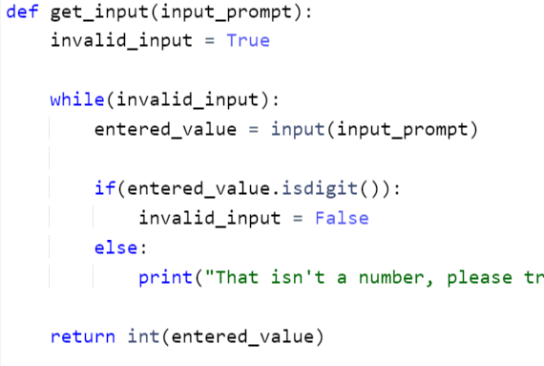
Functioning Code (get_inputs function)

Slide 7
Calculate Sum Pre-defined Process
Start
ADDITION
Add together the numbers for input1 and input2
RETURN
Assign the sum to a sum variable
Stop

Slide 8

Functioning Code (sum_numbers function)

Slide 9
Start
B
CALL get_input()
function
CALL sum_numbers
function
Get Number (input1)
Calculate Sum
CALL get_input()
function
Get Number
(input2)
Print the sum variable
B
Stop

Slide 10
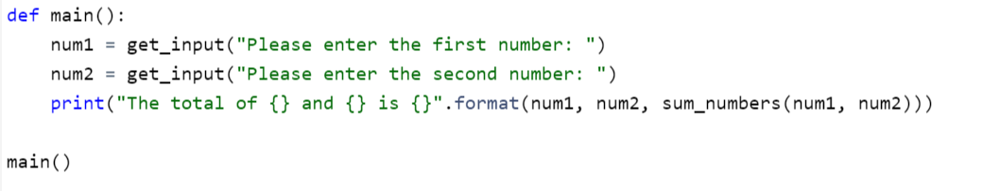
Functioning Code (main function)

Slide 11

Your Turn
Using your algorithm from 6.2 and your flowchart from session 1, write the functioning code for the Fibonacci sequence program.

Slide 12
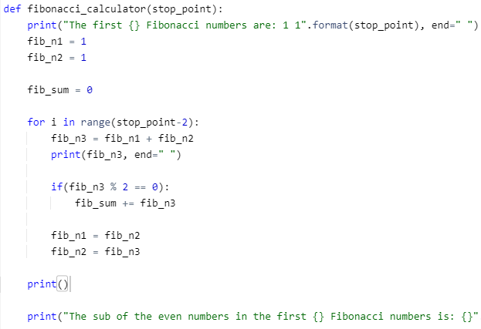
Option 1

Slide 13
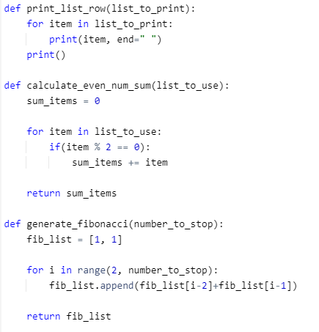
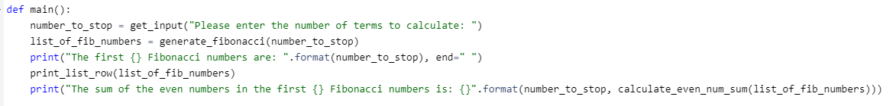
Option 2

Slide 14

Rest of This Class
Worksheet

Slide 15

Summary for this Week
To understand what an algorithm is
To explore algorithmic design
To describe algorithmic complexity
To evaluate the benefits and drawbacks of designing algorithms
To outline the use of a flowchart
To understand the different types of symbol which are utilised within flowcharts
To develop flowcharts with appropriate use of symbols
Implement functioning code making use of flowcharts

Slide 16
Next Week – Project Ideation, Scoping and Documentation
Pre-Session Materials
Innovation in Software Development
Strategies for Driving Innovation
Project Ideation Processes
Hybrid Session 1
Client engagement
Project Scope
Managing Expectations
Hybrid Session 2
Industry Standard Documentation
Software Requirements Specification
System Requirements Specification

